Slide 1
Insertion sort and Searching
Course Code: CSC 2106
Course Title: Data Structure (Theory)
Dept. of Computer Science
Faculty of Science and Technology
Lecturer No: | 3.2 | Week No: | 3 | Semester: | Fall 22-23
Lecturer: | Md. Faruk Abdullah Al Sohan; faruk.sohan@aiub.edu

Slide 2
Lecture Outline
Insertion Sort
Searching
Linear Search (See Lecture 1.2)
Binary Search

Slide 3
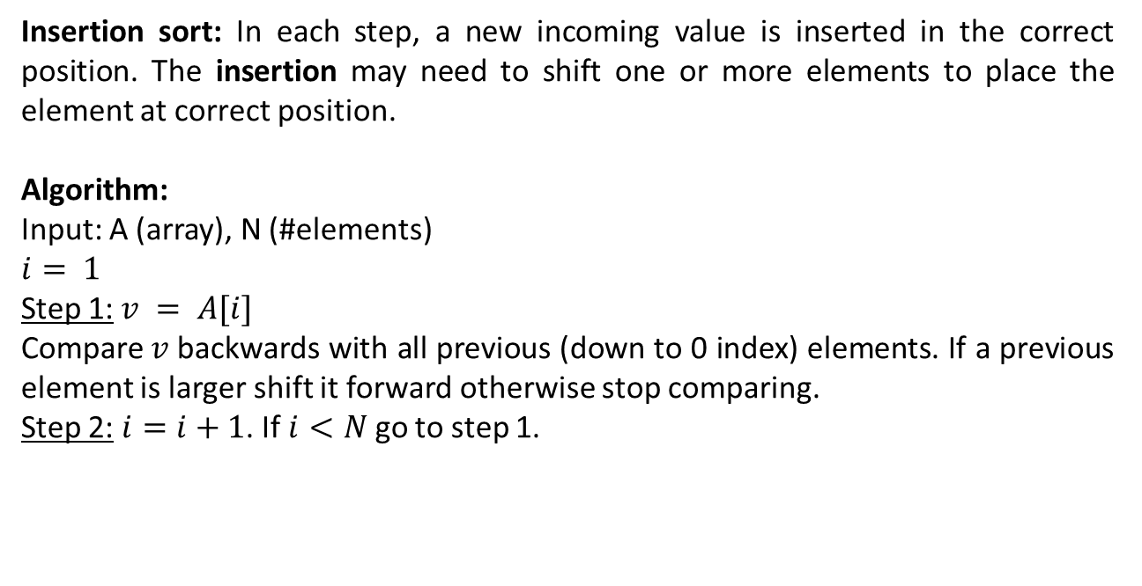
Sorting
Insertion Sort
Insertion sort: In each step, a new incoming value is inserted in the correct position. The insertion may need to shift one or more elements to place the element at correct position.
Algorithm:
Input: A (array), N (#elements)
$$i= 1$$
Step 1:$v = A[i]$
Compare$v$backwards with all previous (down to 0 index) elements. If a previous element is larger shift it forward otherwise stop comparing.
Step 2: $i=i+1$. If $i<N$ go to step 1.

Slide 4
Insertion Sort
Simulation
i
i
i
i
i
i
i
i
i
j
j
j
j
j
j
j
j
j
j
66
22
99
77
11
91
55
88
44
v
22
11
33
66
33
22
66
33
22
77
66
55
44
99
77
99
77
66
55
99
91
77
66
11
99
91
88
77
91
55
99
91
88
88
99
91
44
99
0
1
2
3
4
5
6
7
8
9

Slide 5
Sorting
Exercise
Apply different sorting algorithms (Bubble, Selection and Insertion) to sort the below array. Show step by step simulation.
Also find the number of comparisons, shifting or swapping for each case.
32 | 12 | 67 | 33 | 22 | 88 | 44 | 25

Slide 6
Sorting
Exercises
1: What will happen if we want to apply Bubble, Selection or Insertion sorting algorithms to an array which is already sorted? Think in terms of comparisons, swapping and shifting required in each case.
2: Suppose you have admission test marks of thousands of students with you. The marks are stored in an array. If you require to print the list of names of top 100 students only which sorting algorithm will you choose?
3: In which of the algorithms, a partially sorted list found in a step does not change in the next steps?

Slide 7
Searching
Introduction
Search: locate an item in a list of data/information.
Two approaches will be discussed…
Linear or Sequential Search:
Searches sequentially for an element.
Starts from the first element.
Binary Search:
Searches an element by dividing the sorted elements in a list into two sub-list
Starts with the middle element.

Slide 8
Linear Search
Algorithm and Simulation
Algorithm:
Input: Array, #elements, item (to search)
Start with the element at index = 0
Step 1: Compare the element at index with item. If its equal to item then return index with status “Found” otherwise go to step 2.
Step 2: Increase index by 1. If index is less than #elements go to step 1 otherwise return -1 with status “Not found”.
index
index
index
index
index
index
value
11
false
found
true
0 | 1 | 2 | 3 | 4 | 5 | 6 | 7 | 8 | 9
33 | 66 | 22 | 111 | 77 | 11 | 99 | 55 | 88 | 44
position
5
-1

Slide 9
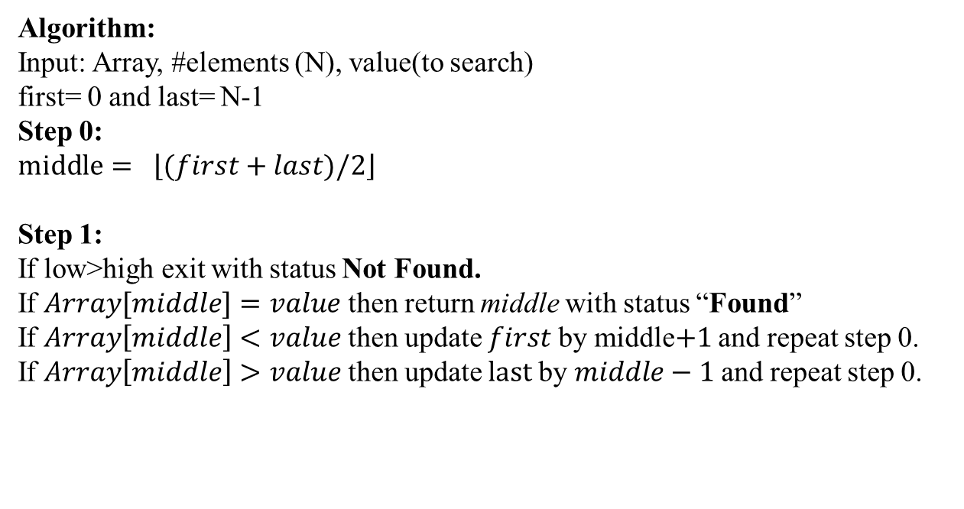
Binary Search
Algorithm
Algorithm:
Input: Array, #elements (N), value(to search)
first= 0 and last= N-1
Step 0:
$$middle= \left\lfloor (first+last)/2\right\rfloor$$
Step 1:
If low>high exit with status Not Found.
If $Array[middle]=value$ then return middle with status “Found”
If $Array\left[middle\right]<value$ then update $first$by middle$+1$ and repeat step 0.
If $Array\left[middle\right]>value$ then update $last$by $middle−1$ and repeat step 0.

Slide 10
Binary Search
Simulation
last
last
last
60
value
77
first
first
first
first
0
5
5
6
5
last
9
11
22
33
44
55
66
77
88
91
99
9
6
6
4
7
5
middle
6
4
0
1
2
3
4
5
6
7
8
9
middle
middle
middle
middle
found
not found

Slide 11
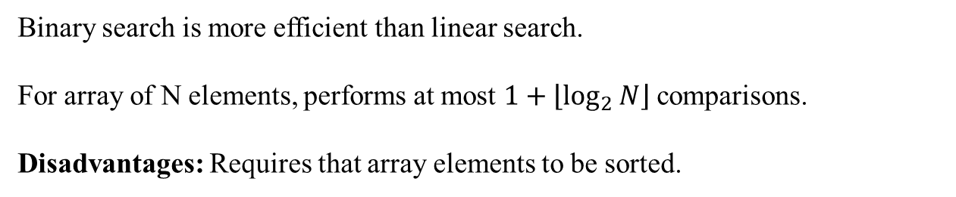
Search
Analysis
Binary search is more efficient than linear search.
For array of N elements, performs at most $1+\left\lfloor \log_{2}{N}\right\rfloor$comparisons.
Disadvantages: Requires that array elements to be sorted.

Slide 12
References
https://en.wikipedia.org/wiki/Insertion_sort
https://en.wikipedia.org/wiki/Sorting_algorithm
Nice animations are available here https://www.cs.usfca.edu/~galles/visualization/ComparisonSort.html
https://en.wikipedia.org/wiki/Linear_search
https://en.wikipedia.org/wiki/Binary_search_algorithm

Slide 13
Books
“Schaum's Outline of Data Structures with C++”. By John R. Hubbard
“Data Structures and Program Design”, Robert L. Kruse, 3rd Edition, 1996.
“Data structures, algorithms and performance”, D. Wood, Addison-Wesley, 1993
“Advanced Data Structures”, Peter Brass, Cambridge University Press, 2008
“Data Structures and Algorithm Analysis”, Edition 3.2 (C++ Version), Clifford A. Shaffer, Virginia Tech, Blacksburg, VA 24061 January 2, 2012
“C++ Data Structures”, Nell Dale and David Teague, Jones and Bartlett Publishers, 2001.
“Data Structures and Algorithms with Object-Oriented Design Patterns in C++”, Bruno R. Preiss,

